Slide 1
Timetabling Improvements
Ben de Sousa, Alexandros Zachakos, Nolan Willoughby,
Todd House, and Conor McArthur

Slide 2

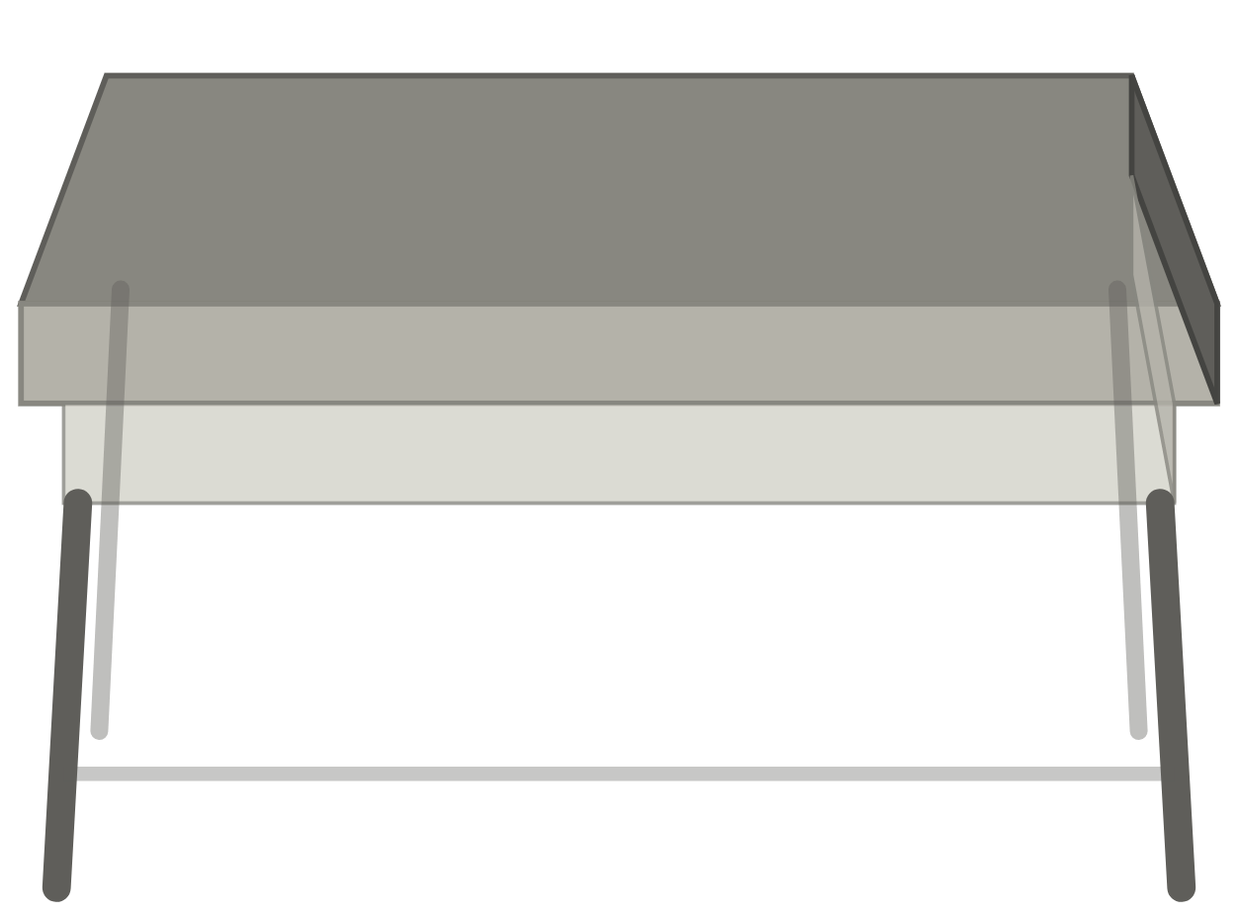

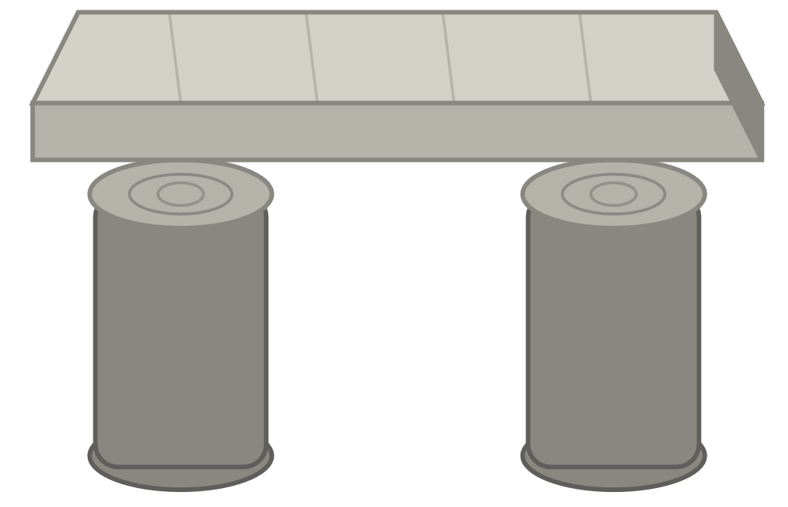
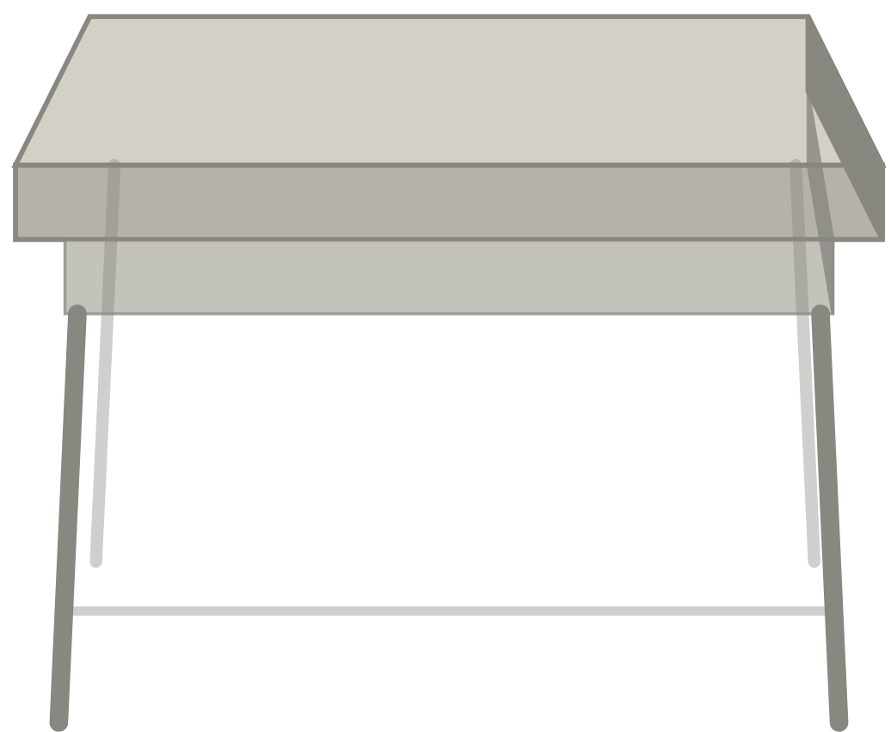
Time Goals
Reduce hours from 9-6 to 9-5
Average room utilisation of 75% of timetable slots
1-hour Lunch break between 12-2pm
Minimisation of clashes including optional courses across different schools
Notes:
Our team set out to try to answer questions from the “Time” related scenario group. We aimed to reduce teaching hours daily to 9-5. We set a goal of average room utilization of 75%, guaranteeing a 1 hour lunch break anytime between 12-2pm, and with the background/undercurrent motivator of minimizing clashes including optional courses across schools.

Slide 3
Motivation
Insert Conor Timetable

Slide 4
Methods
Lit. Review & Data Processing
Model Formulation
Vet School
Multiple Schools
Improvements
Data challenges: formatting, redundant entries, conflicting details
MIP
Vet School tuning
Apply lessons learned to entire school set
Genetic Algorithm

Slide 5
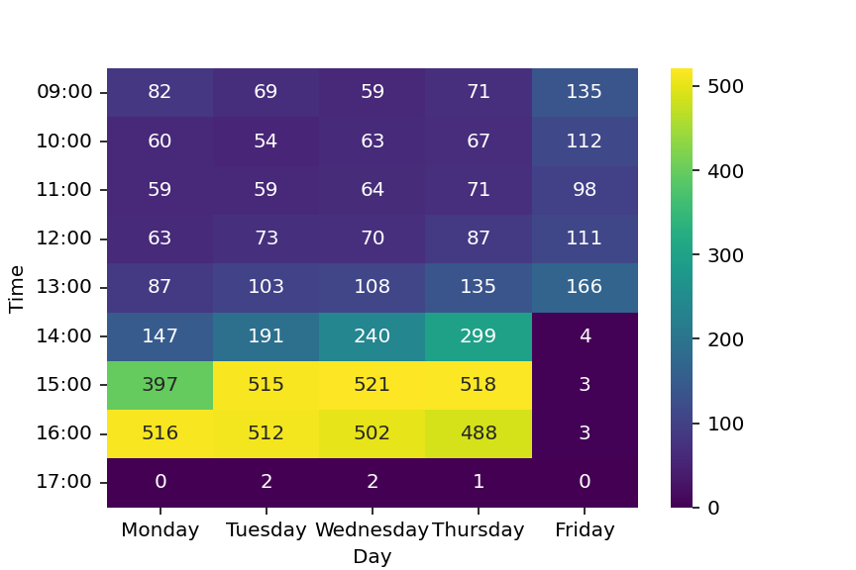
Baseline Results
Notes:
Violations of the daily end time are from the med school which requires too much time for certain courses.

Slide 6
Improved Model Results

Slide 7
Metrics
Table?
Mercury is the closest planet to the Sun and the smallest of them all

Slide 8
Considerations
Improve OR Efficacy
Suitability
Formulation
Constraints
Well suited to problem
Large problem space with difficult to define bounds?
Many relaxations required
Notes:
Suitability
Formulation?
Constraints

Slide 9
Data Restructuring
Recommendations
Refine data entry
Tiered deconfliction meetings
Push for fundamental changes in teaching format
Tracked “sub” degrees
Degree Options
Daily Layout

Slide 10
Thank You
Do you have any questions?

Slide 11
Use our editable graphic resources...
You can easily resize these resources without losing quality. To change the color, just ungroup the resource and click on the object you want to change. Then, click on the paint bucket and select the color you want. Group the resource again when you’re done. You can also look for more infographics on Slidesgo.

Slide 13
JANUARY
FEBRUARY
MARCH
APRIL
MAY
JUNE
PHASE 1
Task 1
Task 2
PHASE 2
Task 1
Task 2
JANUARY
FEBRUARY
MARCH
APRIL
PHASE 1
Task 1
Task 2

